Slide 1
Algorithms: Dynamic Programming
Coin Change Problem

Slide 2
Coin Change Problem
Given unlimited amounts of coins of denominations c₁ > … > c_{d} , give change for amount M with the least number of coins.
Example: c₁ = 25, c₂ =10, c₃ = 5, c₄ = 1 and M = 48
Greedy solution: 25*1 + 10*2 + 1*3 = c₁ + 2c₂ + 3c₄
Greedy solution is
optimal for any amount and “normal’’ set of denominations
may not be optimal for arbitrary coin denominations

Slide 3

Greedy Choice Principles
Suppose you want to count out a certain amount of money, using the fewest possible coins.
At each step, take the largest possible coin that does not overshoot.
Example: To make Tk. 157/-, you,
Choose a Tk. 100/- note,
Choose a Tk. 50/- note,
Choose a Tk. 5/- coin,
Choose a Tk. 2/- coin.

Slide 4
Greedy Choice Principles: Failure
To find the minimum number of US coins to make any amount, the greedy method always works
At each step, just choose the largest coin that does not overshoot the desired amount: 31¢ = (25+5+1)
The greedy method would not work if we did not have 5¢ coins
For 31 cents, the greedy method gives seven coins (25+1+1+1+1+1+1), but we can do it with four (10+10+10+1)
The greedy method also would not work if we had a 21¢ coin
For 63 cents, the greedy method gives six coins (25+25+10+1+1+1), but we can do it with three (21+21+21)
The greedy algorithm results in a solution, but always not in an optimal solution
How can we find the minimum number of coins for any given coin set?

Slide 5
Coin Change Problem: Example
Given the denominations 1, 3, and 5, what is the minimum number of coins needed to make change for a given value?
Value
1
2
3
4
5
6
7
8
9
10
Min # of coins
1
1
1
Only one coin is needed to make change for the values 1, 3, and 5

Slide 6
Coin Change Problem: Example
Given the denominations 1, 3, and 5, what is the minimum number of coins needed to make change for a given value?
Value
1
2
3
4
5
6
7
8
9
10
Min # of coins
1
2
1
2
1
2
2
2
However, two coins are needed to make change for the values 2, 4, 6, 8, and 10.

Slide 7
Coin Change Problem: Example
Given the denominations 1, 3, and 5, what is the minimum number of coins needed to make change for a given value?
Value
1
2
3
4
5
6
7
8
9
10
Min # of coins
1
2
1
2
1
2
3
2
3
2
Lastly, three coins are needed to make change for the values 7 and 9

Slide 8
Coin Change Problem: Recurrence
This example is expressed by the following recurrence relation:
minNumCoins(M-1) + 1
minNumCoins(M-3) + 1
minNumCoins(M-5) + 1
min of
minNumCoins(M) =

Slide 9
Coin Change Problem: Recurrence
Given the denominations c: c₁, c₂, …, c_{d}, the recurrence relation is:
minNumCoins(M-c₁) + 1
minNumCoins(M-c₂) + 1
…
minNumCoins(M-c_{d}) + 1
min of
minNumCoins(M) =

Slide 10
Coin Change Problem: A Recursive Algorithm
RecursiveChange(M, c, d)
if M = 0
return 0
bestNumCoins ← infinity
for i ← 1 to d
if M ≥ c_{i}
numCoins ← RecursiveChange(M – c_{i} , c, d)
if numCoins + 1 < bestNumCoins
bestNumCoins ← numCoins + 1
return bestNumCoins

Slide 11
RecursiveChange is not Efficient
It recalculates the optimal coin combination for a given amount of money repeatedly
i.e., M = 77, c = (1, 3, 7):
Optimal coin for 70 cents is computed 9 times!

Slide 12
The RecursiveChange Tree
77
76
74
70
75
73
69
73
71
67
69
67
63
74
72
68
68
66
62
70
68
64
68
66
62
62
60
56
72
70
66
72
70
66
66
64
60
66
64
60
. . .
. . .
70
70
70
70
70

Slide 13
We Can Do Better
We are re-computing values in our algorithm more than once
Save results of each computation for 0 to M
This way, we can do a reference call to find an already computed value, instead of re-computing each time
Running time M*d, where M is the value of money and d is the number of denominations

Slide 14
Coin Change Problem: Dynamic Programming
DPChange(M, c, d)
bestNumCoins₀ ← 0
for m ← 1 to M
bestNumCoins_{m} ← infinity
for i ← 1 to d
if m ≥ c_{i}
if bestNumCoins_{m – ci}+ 1 < bestNumCoins_{m}
bestNumCoins_{m} ← bestNumCoins_{m – ci}+ 1
return bestNumCoins_{M}
Running time: O(M*d)

Slide 15
DPChange: Example
0
0
1
2
1
2
3
2
0
0
1
2
3
4
5
6
0
1
0
1
2
1
2
3
2
1
0
1
0
1
2
3
4
5
6
7
0
1
2
0
1
2
0
1
2
1
2
3
2
1
2
0
1
2
1
0
1
2
3
4
5
6
7
8
0
1
2
3
0
1
2
1
2
3
2
1
2
3
0
1
2
1
2
0
1
2
3
4
5
6
7
8
9
0
1
2
3
4
c = (1, 3, 7) M = 9
0
1
2
1
2
3
0
1
2
3
4
5

Slide 16
Coin Change Problem
Goal: Convert some amount of money M into given denominations, using the fewest possible number of coins
Input: An amount of money M, and an array of d denominations c = (c₁, c₂, …, c_{d}), in a decreasing order of value (c₁ > c₂ > … > c_{d})
Output: A list of d integers i₁, i₂, …, i_{d} such that
c₁i₁ + c₂i₂ + … + c_{d}i_{d} = M and i₁ + i₂ + … + i_{d} is minimal

Slide 17
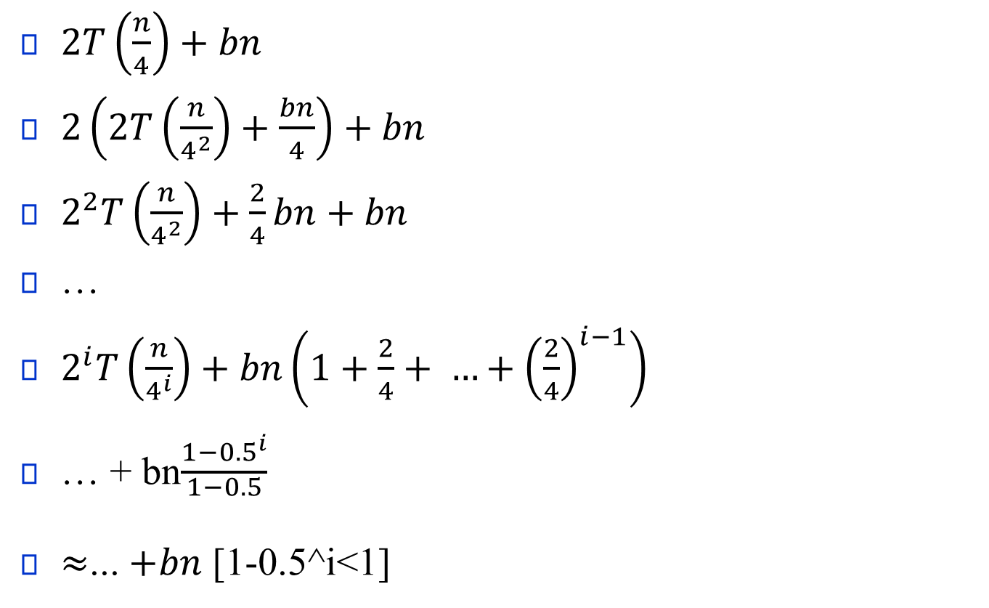
$2T\left(\frac{n}{4}\right)+bn$
$2\left(2T\left(\frac{n}{4^{2}}\right)+\frac{bn}{4}\right)+bn$
$2^{2}T\left(\frac{n}{4^{2}}\right)+\frac{2}{4}bn+bn$
…
$2^{i}T\left(\frac{n}{4^{i}}\right)+bn\left(1+\frac{2}{4}+ …+{\left(\frac{2}{4}\right)}^{i−1}\right)$
… + bn$\frac{1−{0.5}^{i}}{\begin{aligned}1−0.5 \\ \end{aligned}}$
$≈$... $+bn$ [1-0.5^i<1]

Slide 18

dnc(A, l, h)
if (l==h){
if (A[l]>0) return 1;
else return 0;
}
mid = $\frac{l+h}{2}$
c1 = dnc(A,l,mid);
c2 = dnc(A,mid+1,h);
return c1+c2;

